Slide 1

A Comprehensive Look into the State of Air Pollution Globally
Sulaiman Mathew-Wilson
Junior, Howard University
Environmental Studies
COAS Honors Student

Slide 2
Introduction
Data Description: Global dataset used to evaluate different air pollutants all around the world
Pollutants evaluated:
Particulate Matter (PM2.5)
Nitrogen Dioxide (N02)
Ozone (O3)
Carbon Monoxide (CO)
Dataset Use Cases:
Identify pollution trends
Analyze health risks
Derive actionable insights

Slide 3
Background
Health Impacts:
Public health concern
Exposure can lead to cardiovascular & respiratory diseases
Increases the risk of respiratory infections & pulmonary diseases
Importance of air quality data
Fills data gaps
Informs policy
Democratization of information
Informs the public, keeping them aware & engaged
According to HEI’s State of Global Air Report, 8.1 million premature deaths annually are attributed to air pollution

Slide 4
Data Cleaning
Country: Replaced missing values with "Unknown"
Preserve data volume while allowing country-agnostic analysis
City: Dropped rows with missing city names
Geographic analysis requires city-level data; imputation would be unreliable
Result: 1 row removed, 23,462 rows remain

Slide 5
Data Cleaning
Duplicate check
None found
Value Handling
No negative AQI values detected
Zero values retained
Zeros indicate very clean air; it is important that these values remain
Outlier Detection
Outliers identified using IQR
Retained outliers for realistic environmental analysis

Slide 6
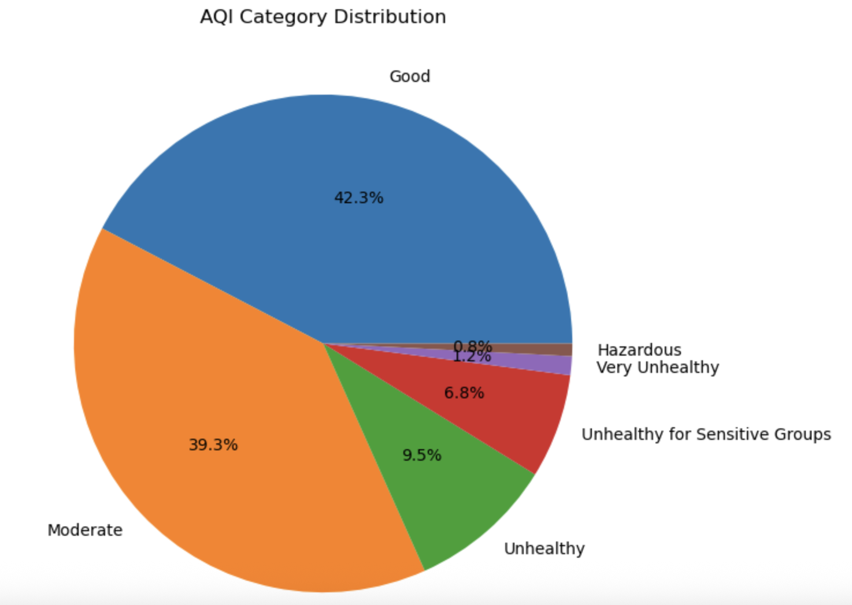
Pie Chart

Slide 7
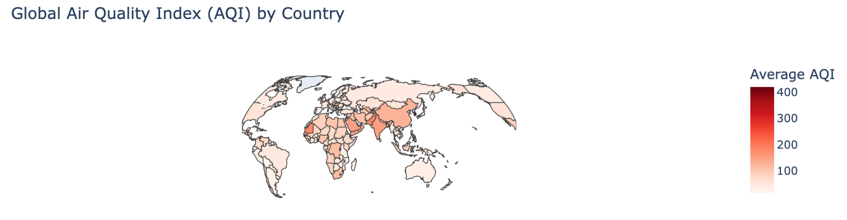
GeoMap

Slide 8
Conclusion
PM2.5 is a major contributor to poor air quality globally
Carbon Monoxide and Ozone show moderate correlations, but vary by region and local emission sources
NO2 is less dominant but remains a concern in urban areas
High risk among areas in Africa, South Asia, Middle East
Urban environments with heavy traffic
Industrial regions

Slide 9
Next Steps
Expand dataset to cover underrepresented areas
Africa
Places with less capacity to conduct monitoring
Policy simulation models
Model impact of emission controls and traffic reductions
Cost-benefit analysis of air quality improvement initiatives
Community engagement tools
Citizen science initiatives for local air monitoring
Educational resources linking AQI to health outcomes
Low-Cost Sensors
More publicly available data

Slide 10
NOW is the time to act.
What do YOU believe should be done to address air inequality?
Thank you for listening!

